Slide 1
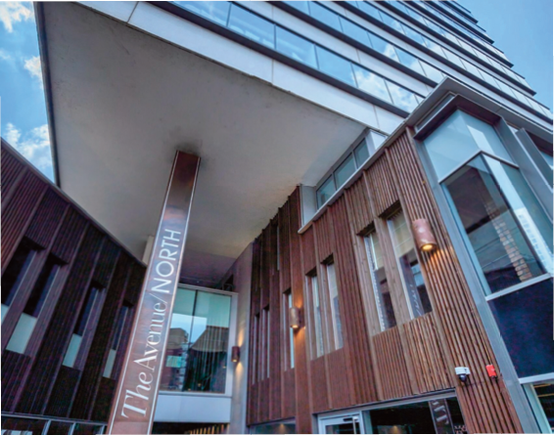


Lincoln House Chambers Autumn Seminar Series
Once image has been inserted, under the Picture Format tab, select Crop, and move/resize the image accordingly. Click outside of the image to deselect
Multi-Session Events Exploring the Cross-Over of Specialist Legal Practice Areas
Join Lincoln House Chambers this autumn for a series of in-depth training days focused on legal cross-over and key developments across our core practice areas. Spanning across three afternoons, these sessions are designed for legal professionals with an established foundation in one area, seeking to develop a broader, multi-disciplinary skillset.
📅 Day 1 – Thursday 25 September
Criminal Law, Transport, Professional Disciplinary & Mental Health
• Crime & Mental Health – Addressing mental health complexities in crime/regulatory cases
• Corporate & Gross Negligence Manslaughter – Defending professionals/organisations.
• Sexual Offences in Disciplinary Cases – Navigating crossover with criminal implications.
• Transport Law – Covering traffic commissioner interventions and regulatory overlap.
Speakers include: Richard English KC, Clare Ashcroft, John Harrison KC, Simon Gurney, Richard Dawson & others
📅 Day 2 – Thursday 9 October
Regulatory Law, Assets, Raids, H&S, Trading Standards, Environment
• H&S Update – Key developments in health & safety law.
• Investigations, Assets & Raids – Early stage strategy for corporate clients.
• Restraint & Civil Recovery – Managing cases with restrained assets.
• Trading Standards (Prosecution & Defence) – Insight for both prosecutors and defence.
Speakers include: Andrew Thomas KC, David Pojur, Anam Khan, Paul Williams.
📅 Day 3 – Thursday 6 November
Inquests: Coronial Law, Healthcare, Local Authorities
• Inquest Law Update – Recent changes and implications.
• Healthcare Inquests – Representing healthcare providers.
• Inquests for Criminal Solicitors – for clients that are IPs/have significant interest in inquest proceedings.
• Local Authority Inquests – Considerations for local authority IPs.
• Work-Related Stress, Bullying & Mental Health Inquests
Speakers include: David Pojur, Paul Williams, Austin Welch.
Each day concludes with a networking opportunity.
To register interested or to reserve a place please email: events@lincolnhousechambers.com
Tower 12, The Avenue North, Spinningfields, 18-22 Bridge Street, Manchester, M3 3BZ E: clerks@lincolnhousechambers.com W :www.lincolnhousechambers.com

